Slide 1
BLM2041 Signals and Systems
Syllabus
The Instructors:
Doç. Dr. Ali Can Karaca
ackaraca@yildiz.edu.tr
Dr. Öğr. Üyesi Erkan Uslu
euslu@yildiz.edu.tr

Slide 2
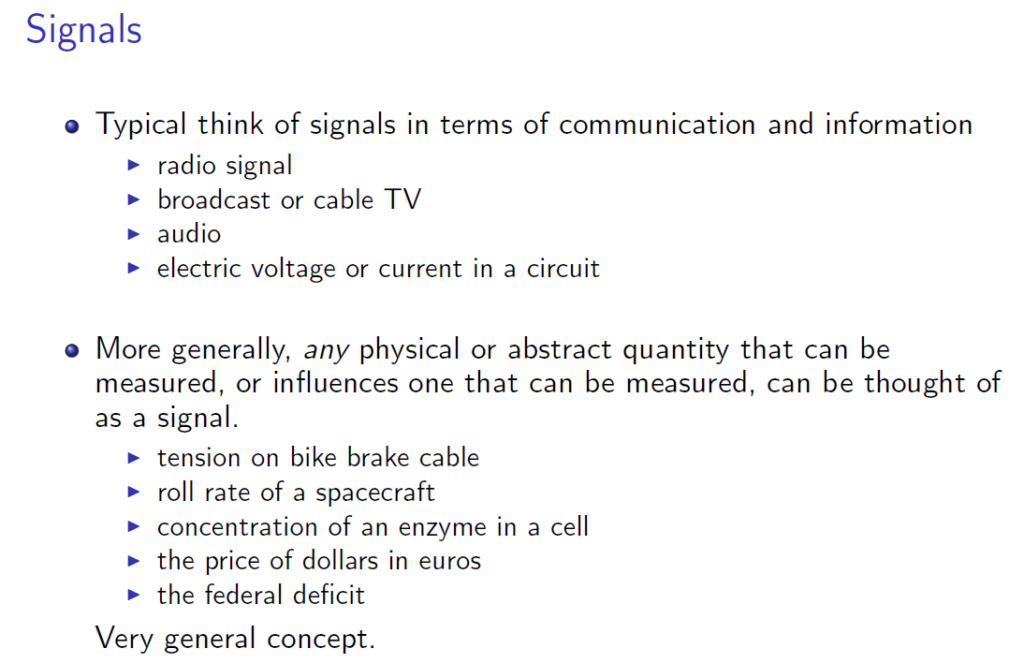
Notes:
Ölçülebilen herhangi bir fiziksel miktar, herhangi bir fiziksel büyüklük hakkında bilgi taşıyan matematiksel fonksiyonlar.
Dolar ücretinin Euro cinsinden değeri + bisiklet fren kablosunun gerilimi + bir hücredeki enzim konsantrasyonu

Slide 3
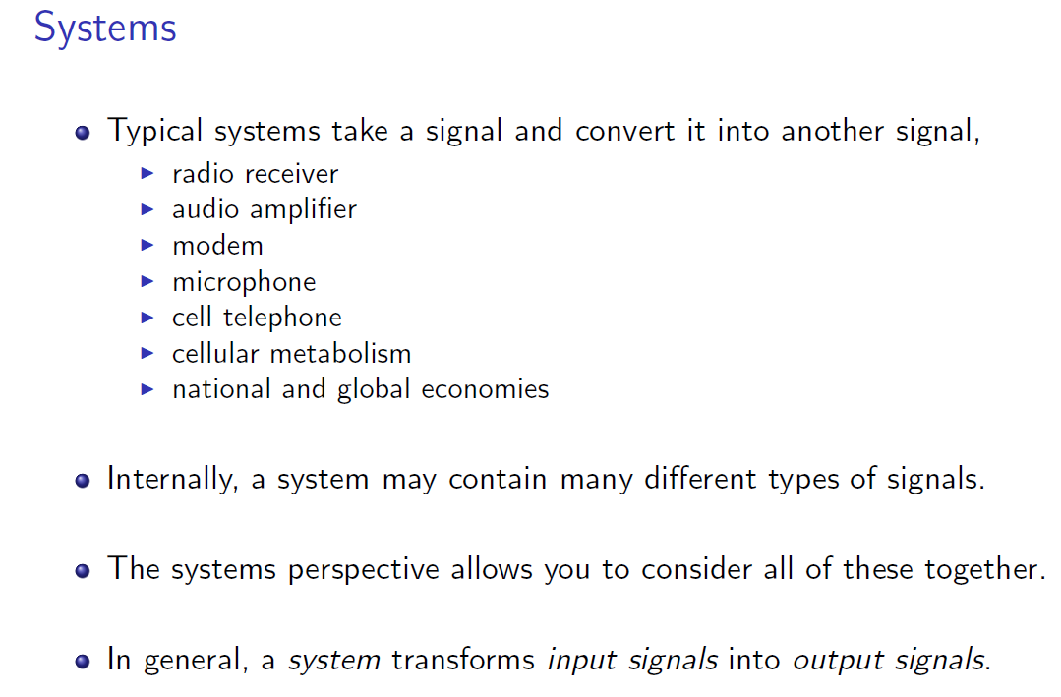

Slide 4
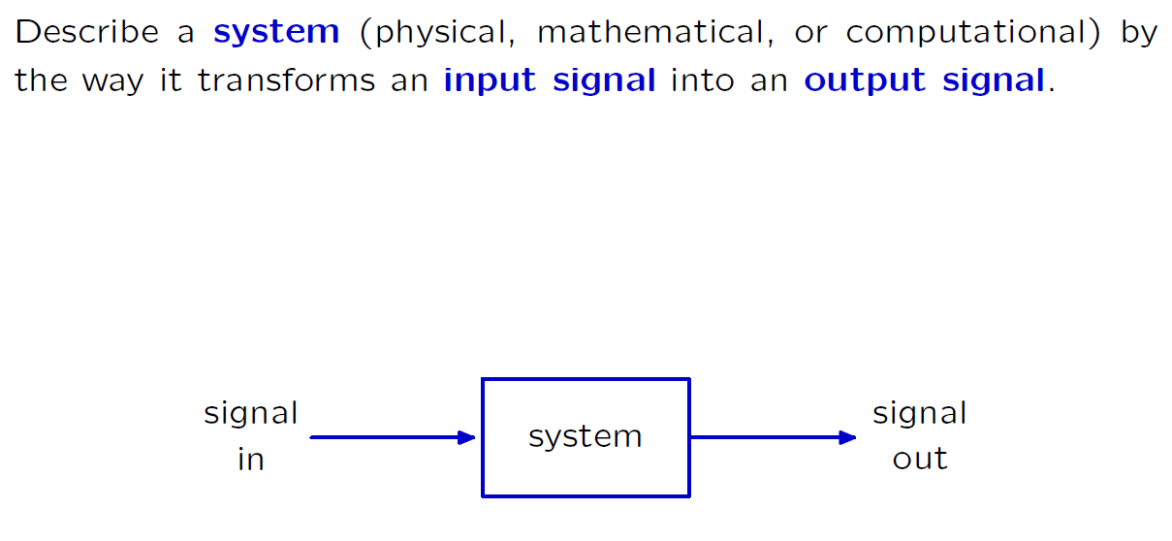

The Signals and Systems Abstraction

Slide 5
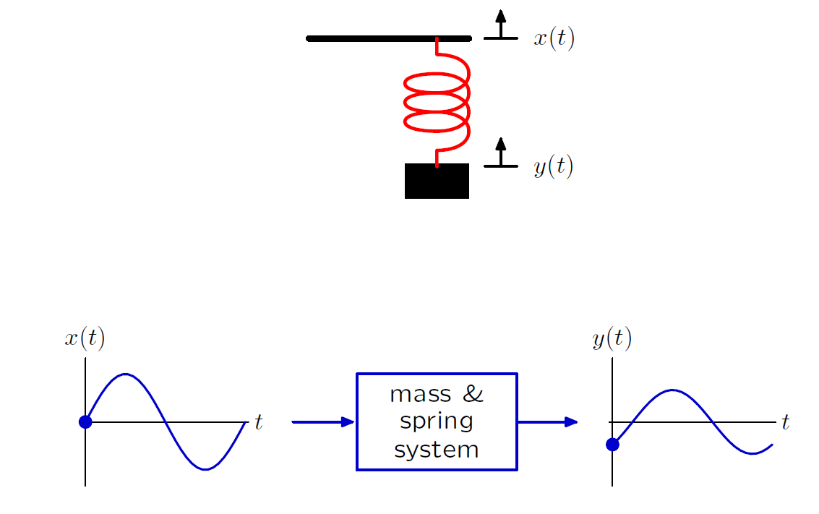
Example: Mass and Spring

Slide 6
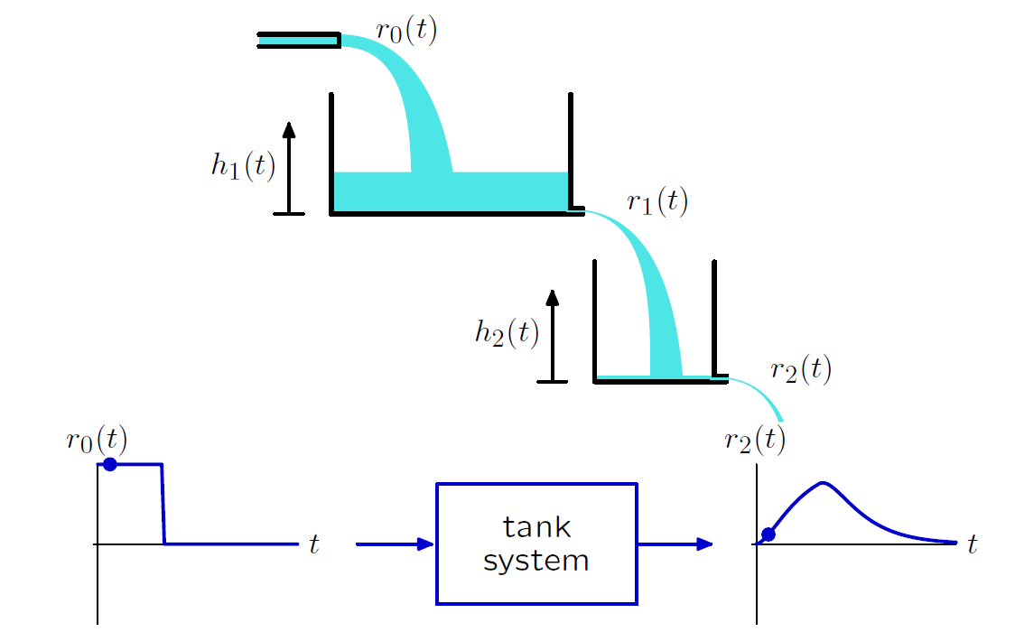
Example: Tanks

Slide 7
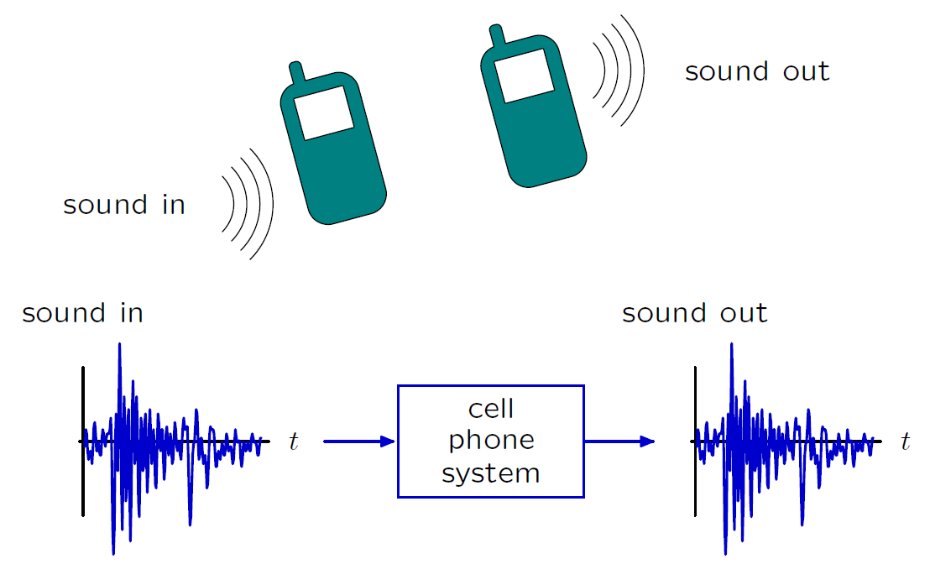
Example: Cell Phone System

Slide 8
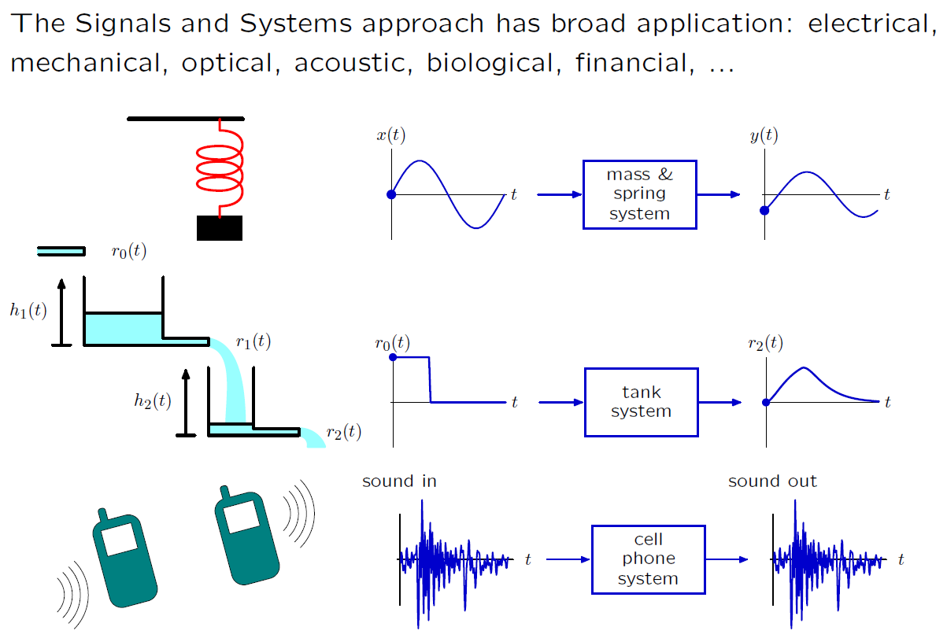
Signals and Systems: Widely Applicable

Slide 9
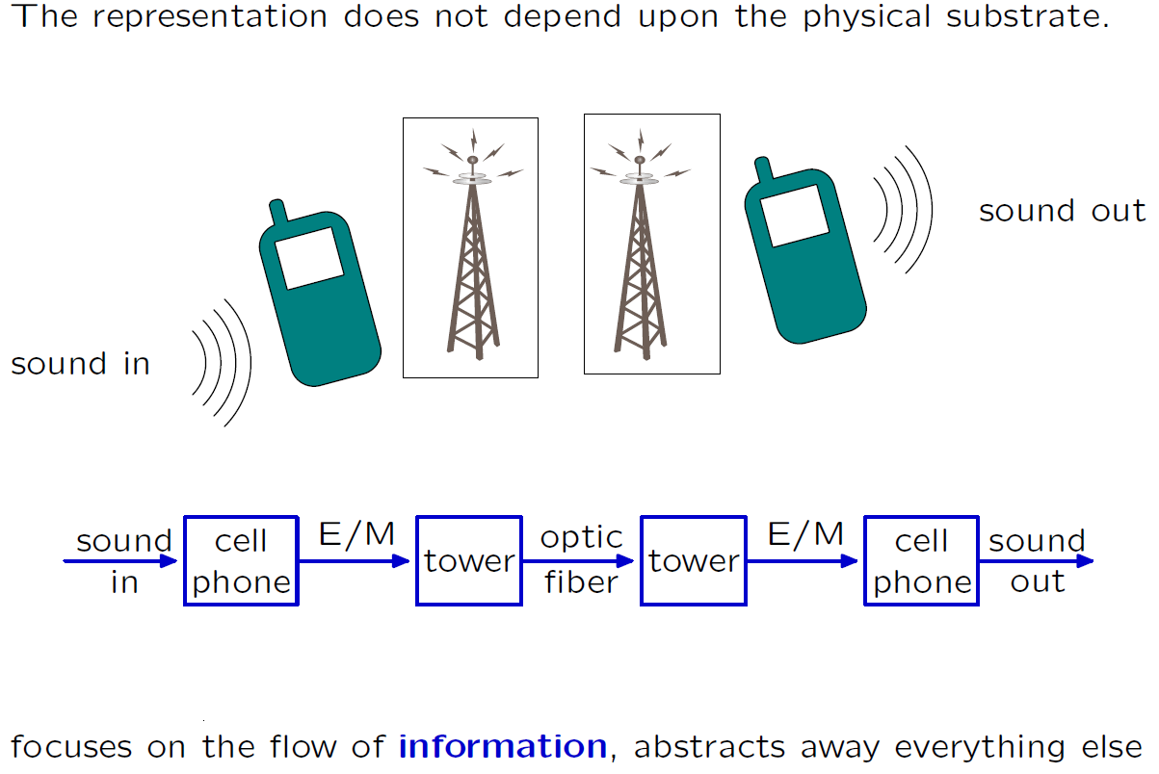
Signals and Systems: Modular

Slide 10
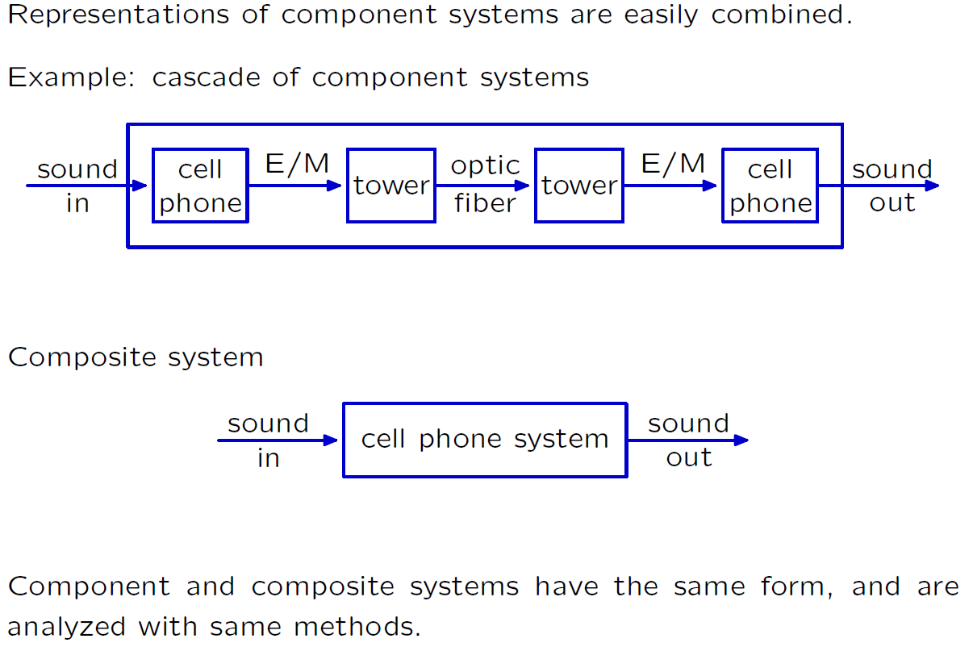
Signals and Systems: Hierarchical
Notes:
Bileşen ve kompozit sistemleri aynı forma sahiptirler ve aynı methodlarla analiz edilirler.

Slide 11
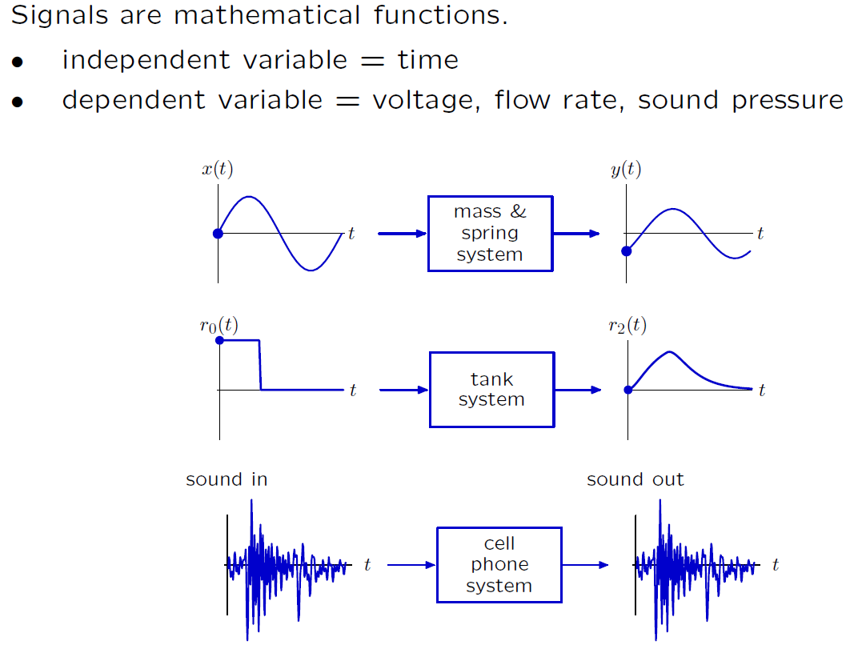
Signals and Systems

Slide 12
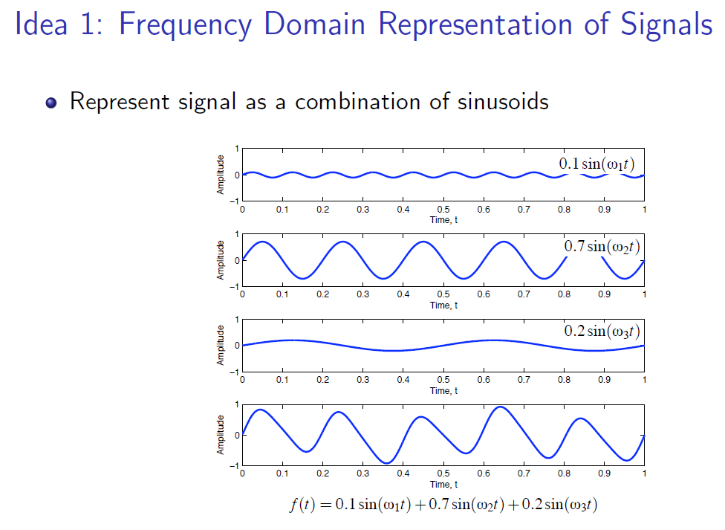
Why Frequency Domain?

Slide 13
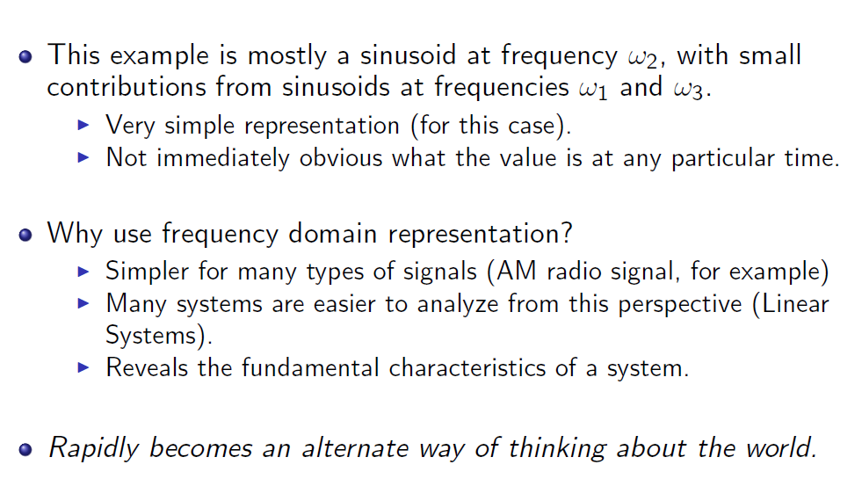
Why Frequency Domain?
Notes:
Aslında dünya hakkında düşünmek için alternatif bir yol sunuyor. Evrenin gizemini anlamak istiyorsanız; enerji, frekans ve titreşim cinsinden düşünün. Tesla

Slide 14
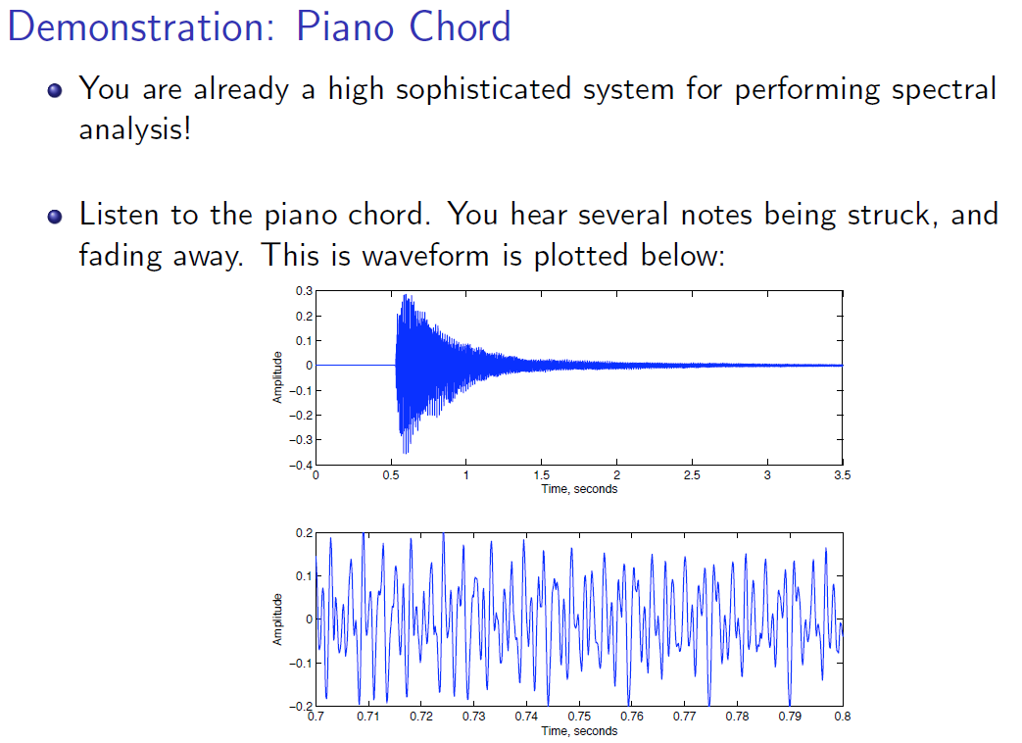
Why Frequency Domain?
Notes:
Piyano akoru

Slide 15
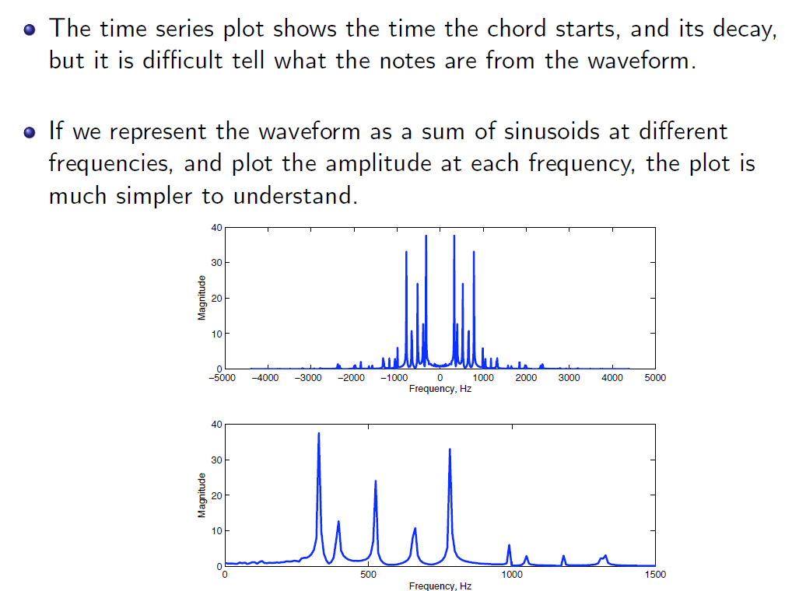
Why Frequency Domain?

Slide 16
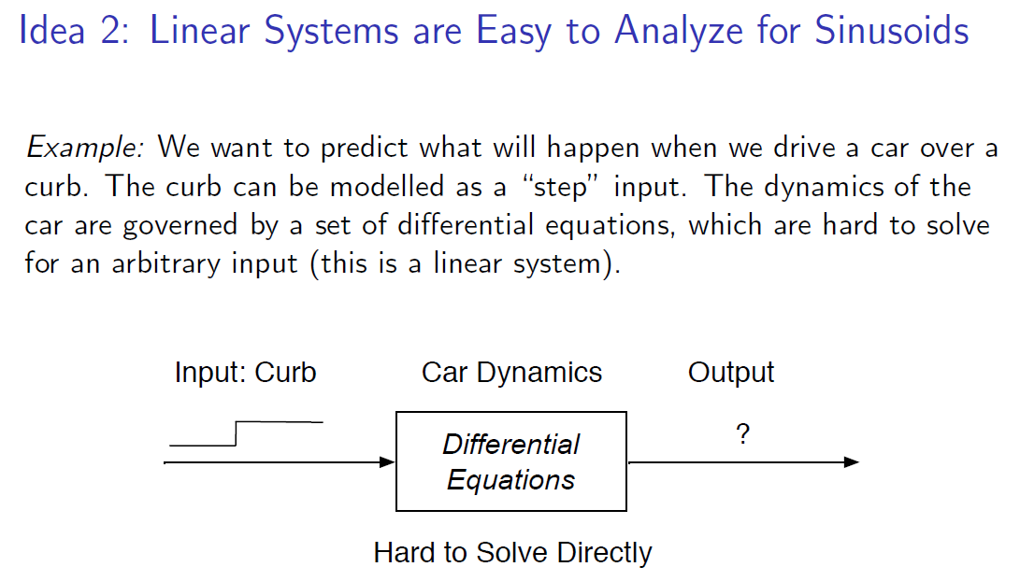
Why Frequency Domain?

Slide 17
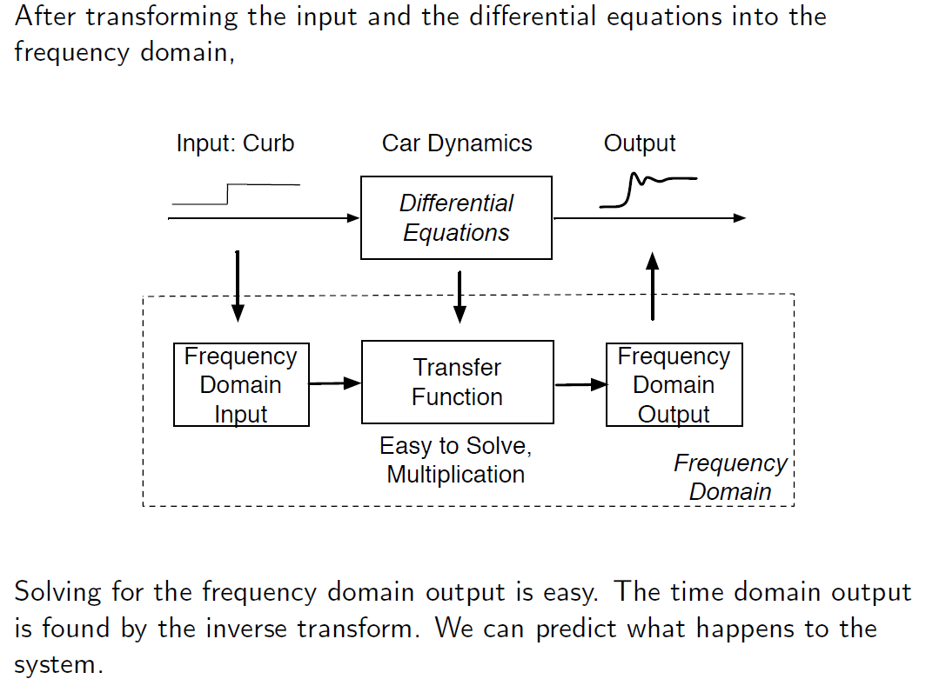
Why Frequency Domain?

Slide 18
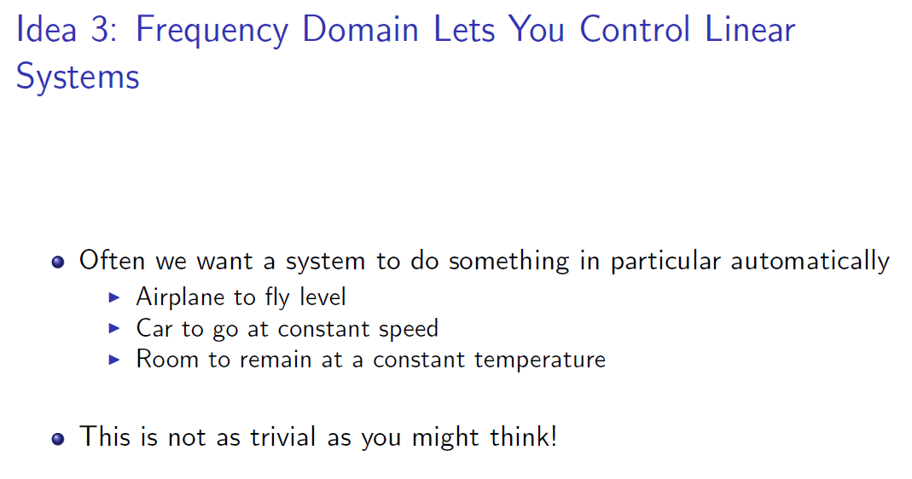
Why Frequency Domain?
Notes:
Düşündüğünüz kadar basit değil

Slide 19
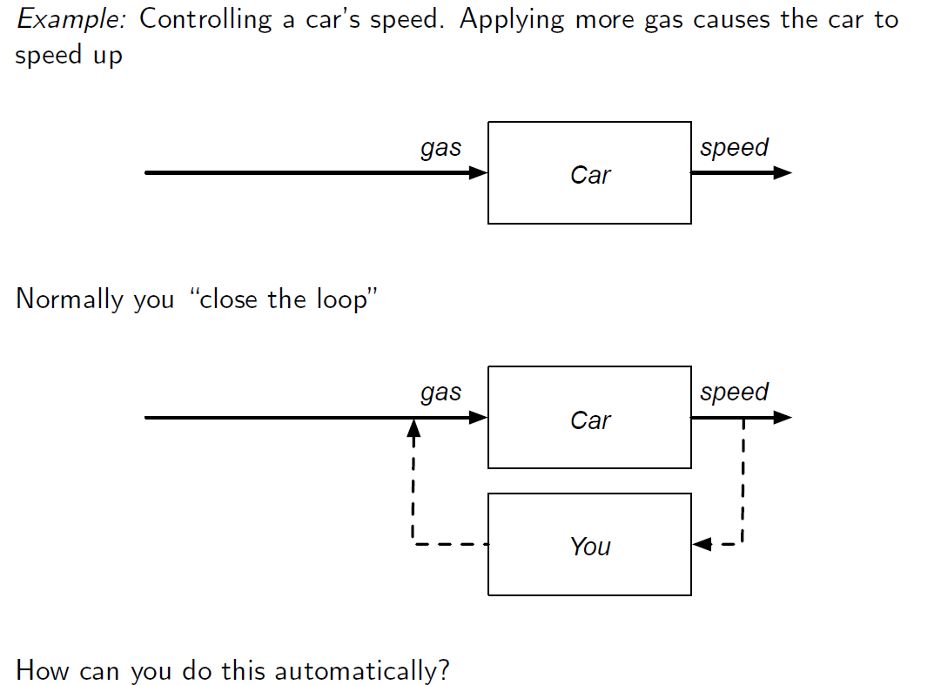
Why Frequency Domain?

Slide 20
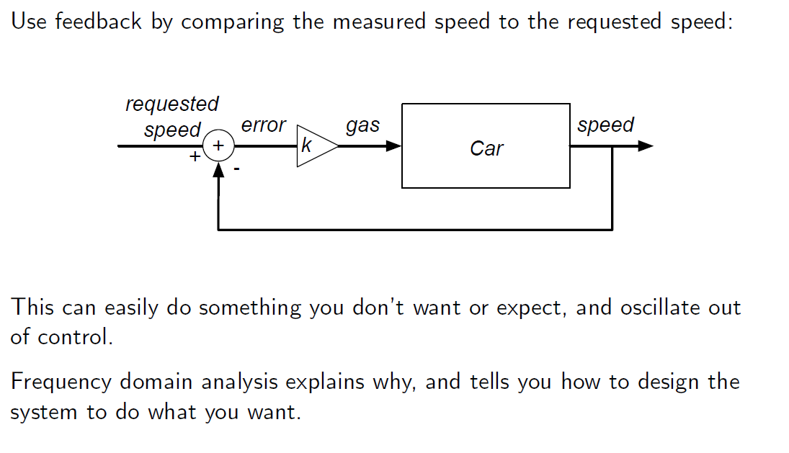
Why Frequency Domain?

Slide 21
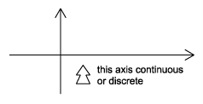
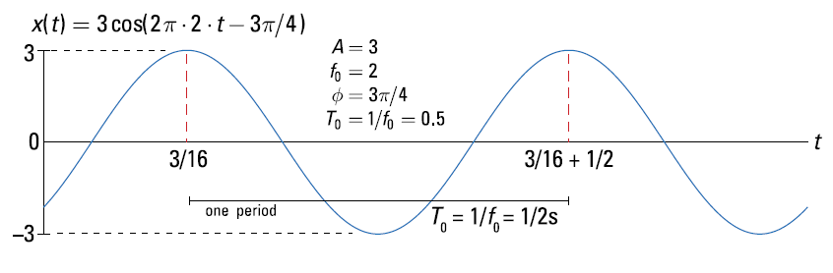
Classifications of Signals
Continuous-Time vs. Discrete-Time
- As the names suggest, this classification is determined by whether or not the time axis is discrete (countable) or continuous.
- A continuous-time signal will contain a value for all real numbers along the time axis.
-In contrast to this, a discrete-time signal, often created by sampling a continuous signal, will only have values at equally spaced intervals along the time axis.

Slide 22
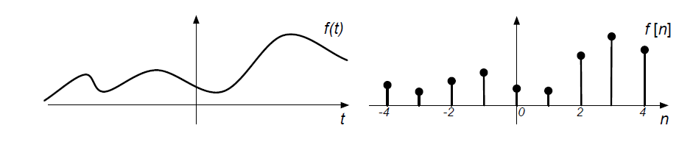
Classifications of Signals
Continuous-Time vs. Discrete-Time
- As the names suggest, this classification is determined by whether or not the time axis is discrete (countable) or continuous.
- A continuous-time signal will contain a value for all real numbers along the time axis.
-In contrast to this, a discrete-time signal, often created by sampling a continuous signal, will only have values at equally spaced intervals along the time axis.
Continuous
Discrete

Slide 23
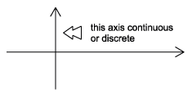
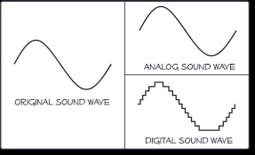
Classifications of Signals
Analog vs. Digital
- The difference between analog and digital is similar to the difference between continuous-time and discrete-time.
- However, in this case the difference involves the values of the function. Analog corresponds to a continuous set of possible function values, while digital corresponds to a discrete set of possible function values.
- An common example of a digital signal is a binary sequence, where the values of the function can only be one or zero.
Analog – Digital Signal Example

Slide 24
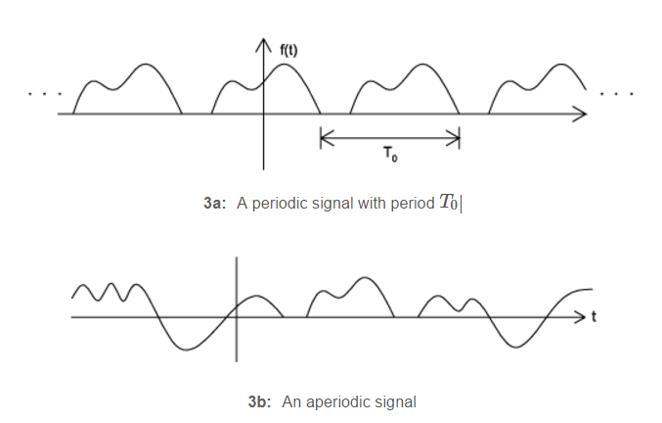

Classifications of Signals
Periodic vs. Aperiodic
Periodic signals repeat with some period T, while aperiodic, or nonperiodic, signals do not. We can define a periodic function through the following mathematical expression, where t can be any number and T is a positive constant
fundamental period of our function, f(t), is the smallest value of T that the still allows Equation to be true.

Slide 25
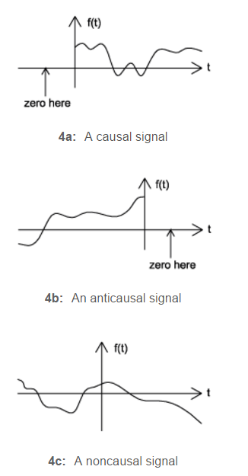
Classifications of Signals
Causal vs. Anticausal vs. Noncausal
Causal signals are signals that are zero for all negative time, while anticausal are signals that are zero for all positive time.
Noncausal signals are signals that have nonzero values in both positive and negative time

Slide 26
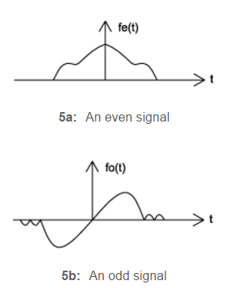
Classifications of Signals
Even vs. Odd
- An even signal is any signal f such that f(t)=f(−t).
Even signals can be easily spotted as they are symmetric around the vertical axis.
- An odd signal, on the other hand, is a signal f such that f(t)=−f(−t)

Slide 27

Even – Odd Decomposition
Using the definitions of even and odd signals, we can show that any signal can be written as a combination of an even and odd signal. That is, every signal has an odd-even decomposition.
To demonstrate this, we have to look no further than a single equation
By multiplying and adding this expression out, it can be shown to be true.
Also, it can be shown that f(t)+f(−t) fulfills the requirement of an even function,
while f(t)−f(−t) fulfills the requirement of an odd function.

Slide 28
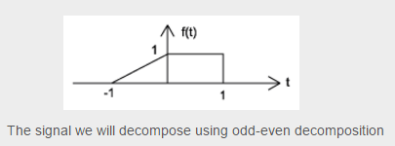
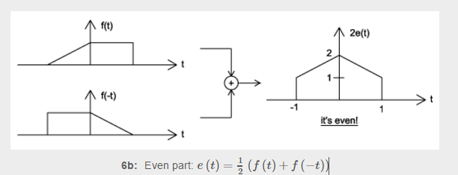
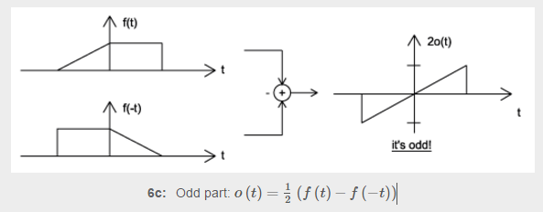
Even – Odd Decomposition Example

Slide 29
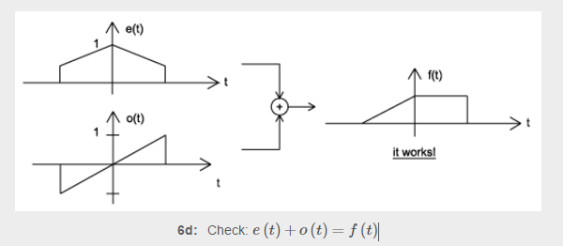
Even – Odd Decomposition Example

Slide 30
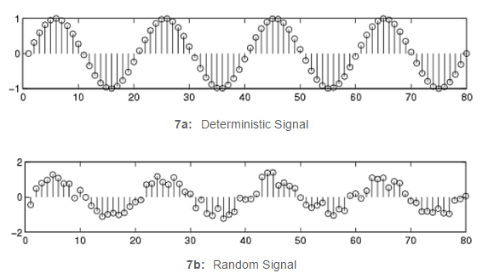
Classifications of Signals
Deterministic vs. Random
A deterministic signal is a signal in which each value of the signal is fixed, being determined by a mathematical expression, rule, or table. On the other hand, the values of a random signal are not strictly defined, but are subject to some amount of variability.

Slide 31

Example
Consider the signal defined for all real t described by
Write down the properties of this signal
This signal is continuous time, analog, aperiodic, infinite length, causal, neither even nor odd, and, by definition, deterministic.

Slide 32
Example
% Code written for Last Example in Lecture1
clc
clear all
close all
t1 = 1:0.01:10;
t2 = -10:0.01:1-0.01;
timeAxis = [t2 t1];
MySignal = [zeros(1,length(t2)) sin(2*pi*t1)./t1];
plot(timeAxis,MySignal)
ylabel('Amplitude', 'fontsize', 20)
xlabel('time', 'fontsize', 20)
title('My First Signal','fontsize', 20)

Slide 33
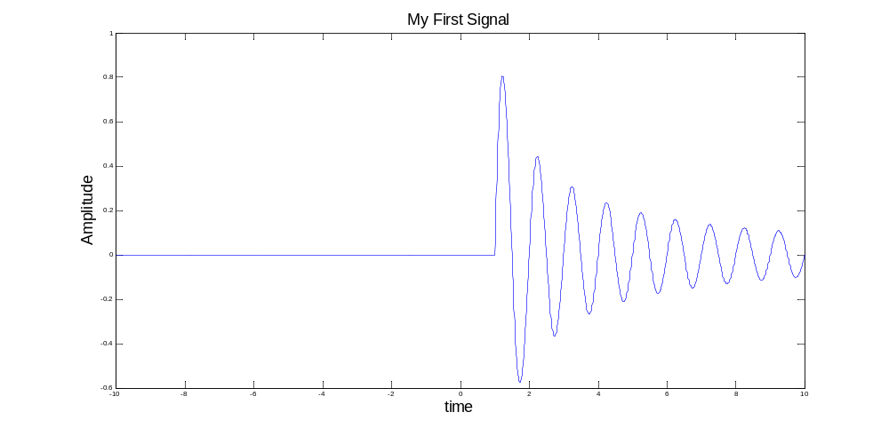
Example

